Slide 1
Learning the Alphabet EDU250-Pod 3 Online Fall/2018
Aviance Hines, Marie Molin, Ella Mitchell

Slide 2
Student Learning Objective
At the conclusion of this activity, the learner
shall be able to match the term with the concept.

Slide 3
Assessment
At the conclusion of this activity, the learner
shall be able to match the term with the concept.

Slide 4
Extension
Computer Center
Adding to the Call List
Parental Involvement
The children will be able to use the computer to practice letter sounds own their on.
Students can add words to call list test them to see if they have actually learned.
The parent will be assisting the child by recalling words that are on the call list. This will help the child learn beginning sounds and letter association with the pictures provided.

Slide 5
BEHAVIORISM
Provide multiple reasons why this activity supports the SLO.
How does this activity allow the student to master the content?
Provide an explanation as to why this activity is an application of the
behaviorist learning theory.
This Bingo game is a stimulus / response activity. The learning is passive and engages the lower order thinking skills.
The learner will be conditioned to associate the phonetic sound with a letter symbol by playing the Bingo game. The phonetic sound will evoke the correct letter association. The learner will demonstrate the ability to match the letter to the sound and recall other words that are not included in the list. At this point the learner will have demonstrated a mastery the concept.

Slide 6
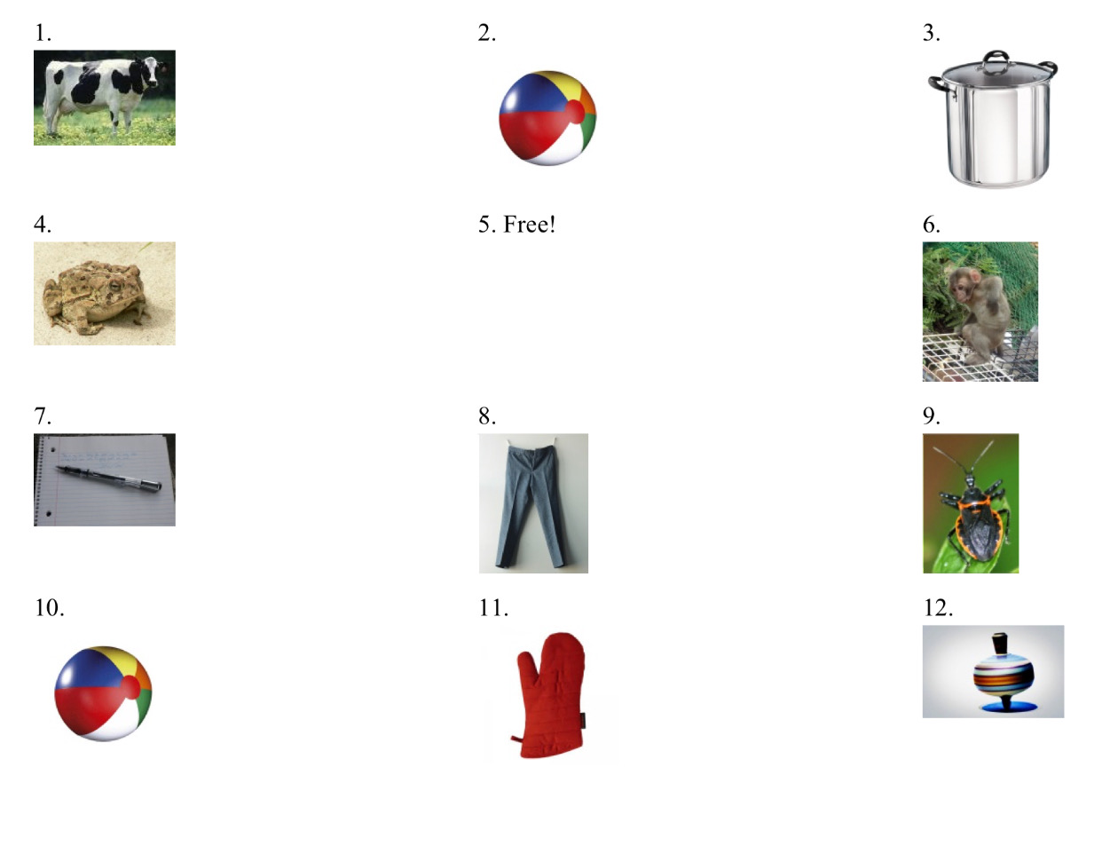
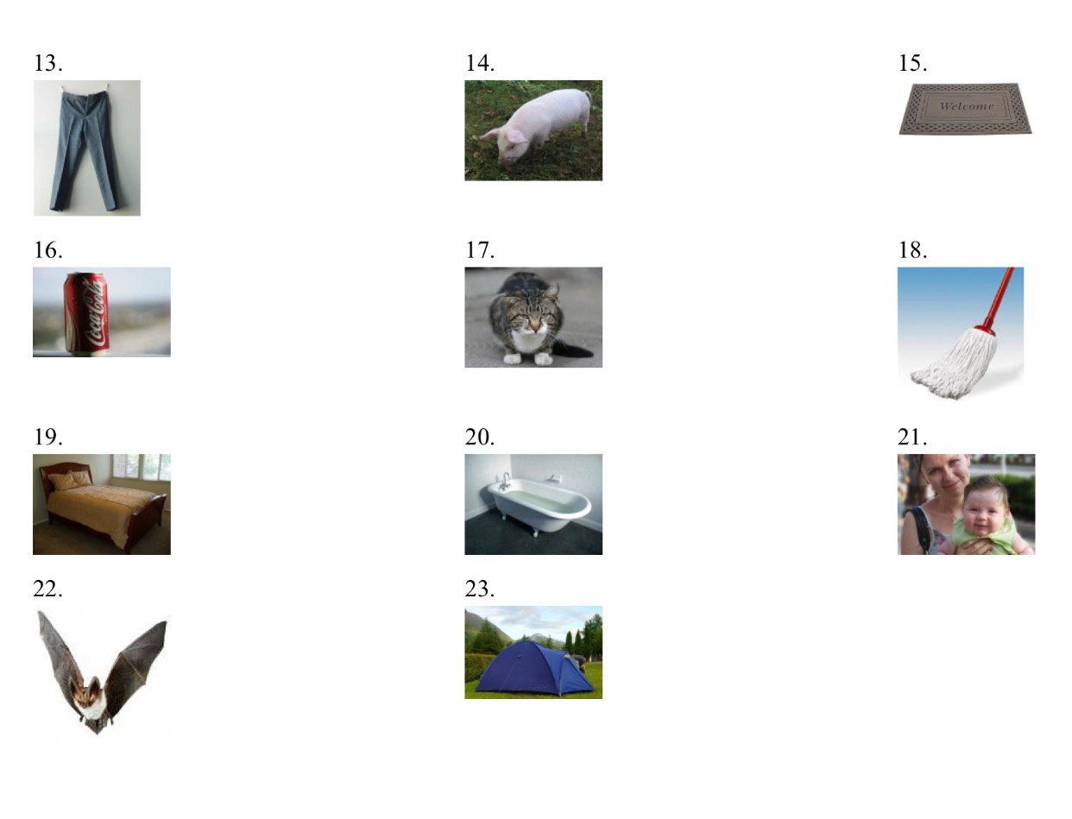
Call List

Slide 7
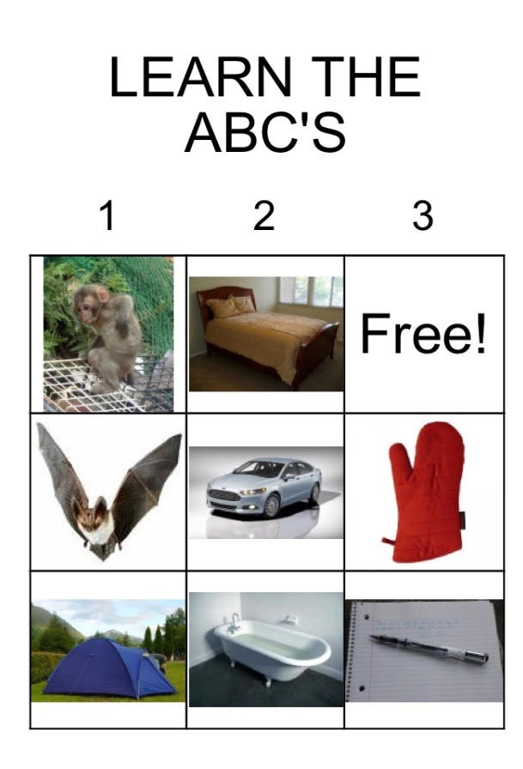

Slide 8
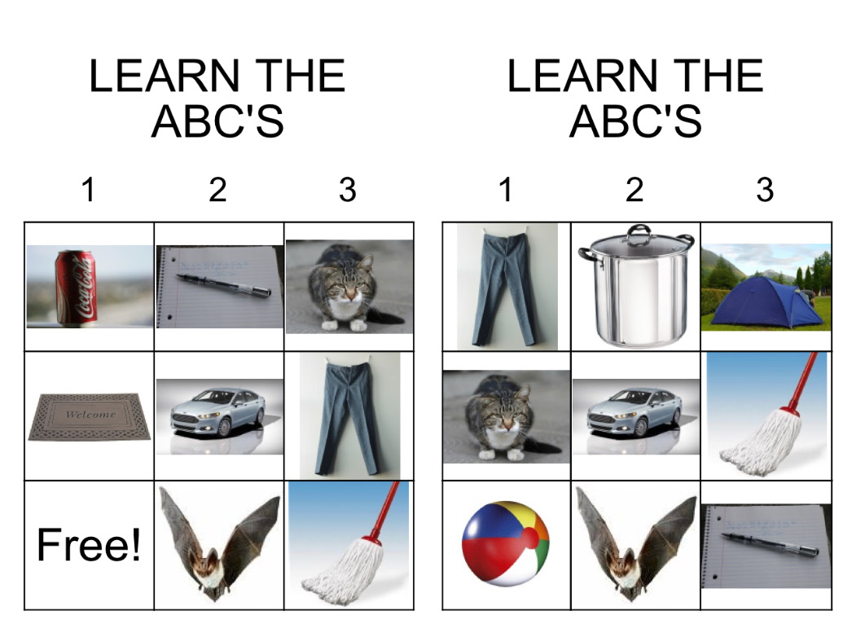
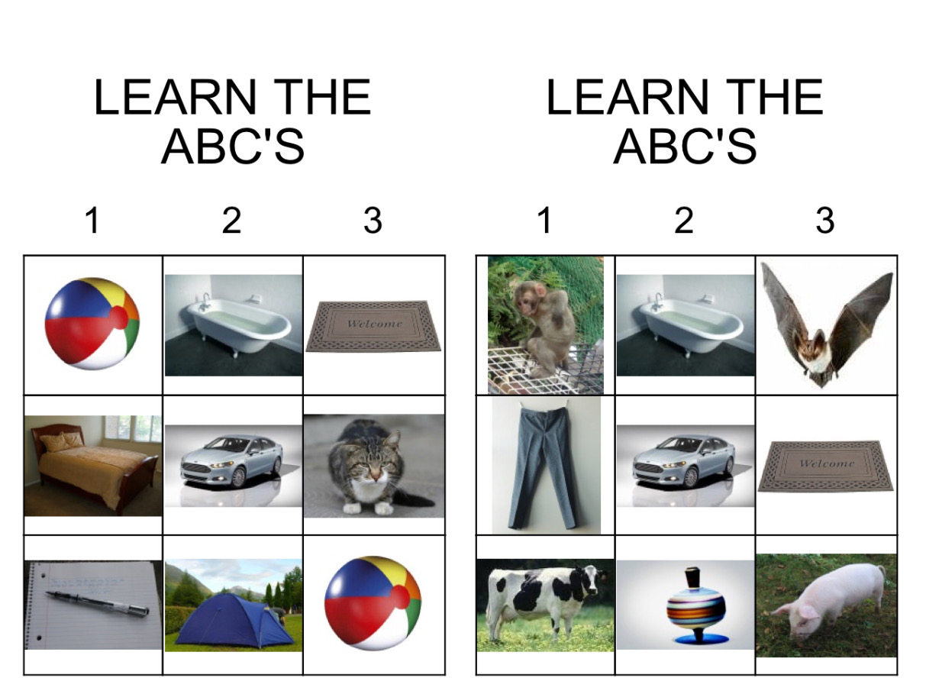
Learning the ABC’S

Slide 9
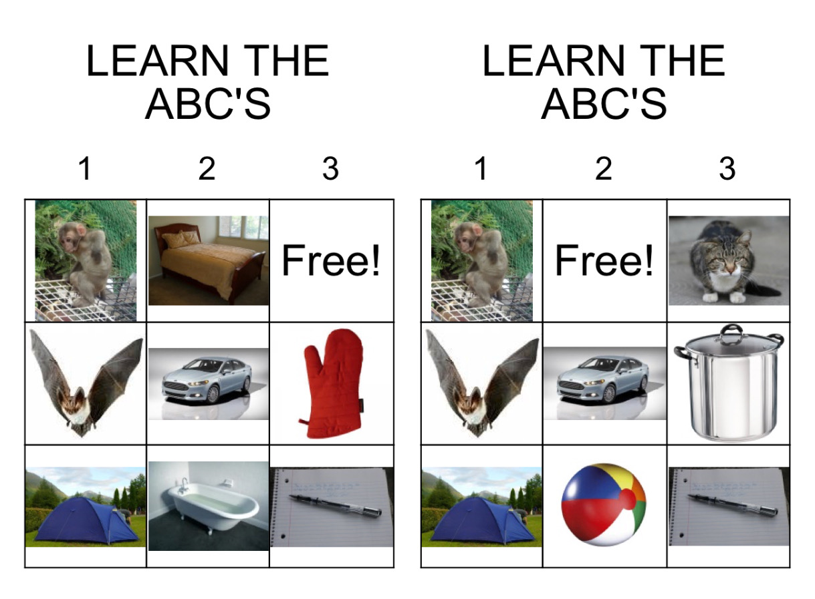
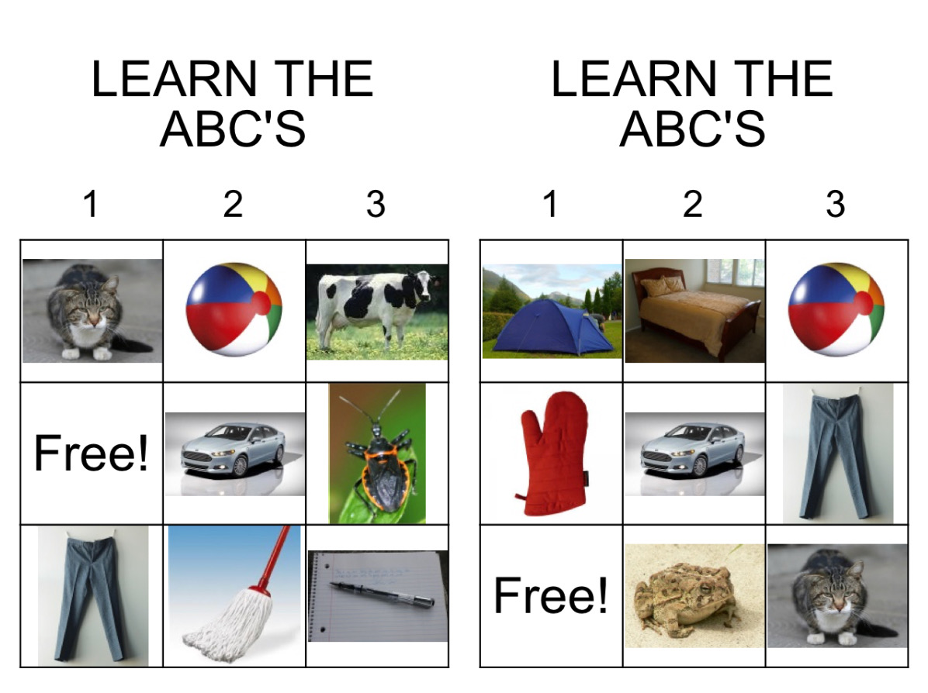
Learning the ABC’S

Slide 10

mop

Slide 11
can

Slide 12
car

Slide 13
cat

Slide 14
cow

Slide 15
tub

Slide 16
top

Slide 17
tent

Slide 18
toad

Slide 19
pot

Slide 20
pig

Slide 21
pants

Slide 22
pen

Slide 23
bat

Slide 24
ball

Slide 25
bug

Slide 26
monkey

Slide 27
mat

Slide 28
mom

Slide 29
bed

Slide 30
mitt

Slide 31
POD 3 ZoomSession-Bingo
https://youtu.be/k8JYD72Ewbw

Slide 32
Credits
Alphabet. (n.d.). Retrieved from https://quizlet.com/2697046/alphabet-flash-cards/
Bingo Cards. (n.d.). Retrieved October 14, 2018, from https://bingobaker.com/?bingo_id=1758222

